Slide 1


Translating Unstructured Texts into Structured Data: A Sate of the Art
Awanish Ranjan
Rabindra Bista
Dept of Computer Science and Engineering, Kathmandu University
Nepal

Slide 2
Topics Covered
Introduction
Application Areas
Classification of tools
Comparative study of NLP systems
Future Direction
References

Slide 3
Introduction
Study of different tools for converting the unstructured text to the structured information
NLP (Natural Language Processing) techniques
Clinical domain
Extracting meaningful information like diagnosis, procedures & drug from the clinically rich texts
Difficulty
  Use of abbreviations like dr., pt., dx, rx. etc.
  Ambiguity
  Not always following correct grammar rules

Slide 4
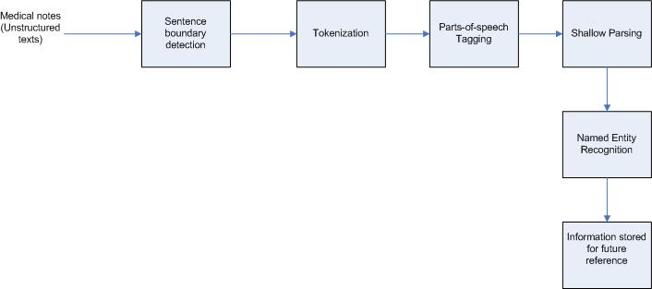
Block diagram

Slide 5
Application Areas
Extracting information from family history
Extracting information from notes taken by physician and nurses during appointment session
Extracting information from prescription by physician – Medication information
Extracting information from discharge summary
Document Classification – Classifying different medical documents

Slide 6
Tools - MedEx
Designed by Xu. H. et.al
Extracts following medication information from discharge summary
  Drug name
  Drug Strength
  Route
  Frequency
Three step process
  Preprocessing – detecting sentence boundary
  Semantic Tagging - each clinical sentence is broken down in tokens and each token is labeled with a semantic category like Drug name, drug strength etc.
  Parsing - context-free grammar to parse the textual sentences into structured form using a chart parser

Slide 7
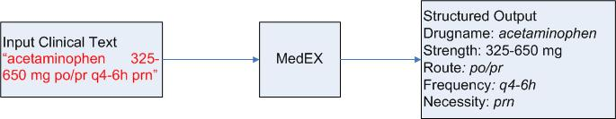
MedEX block diagram

Slide 8
Tools - cTAKES
clinical Text Analysis and Knowledge Extraction System (cTAKES)
Developed by Shovava K.G. et.al
Information extraction from EMR data
Based on following open source technologies
  Unstructured Information Management Architecture (UIMA) framework
  OpenNLP
Data used – subset of clinical notes from Mayo Clinic EMR

Slide 9
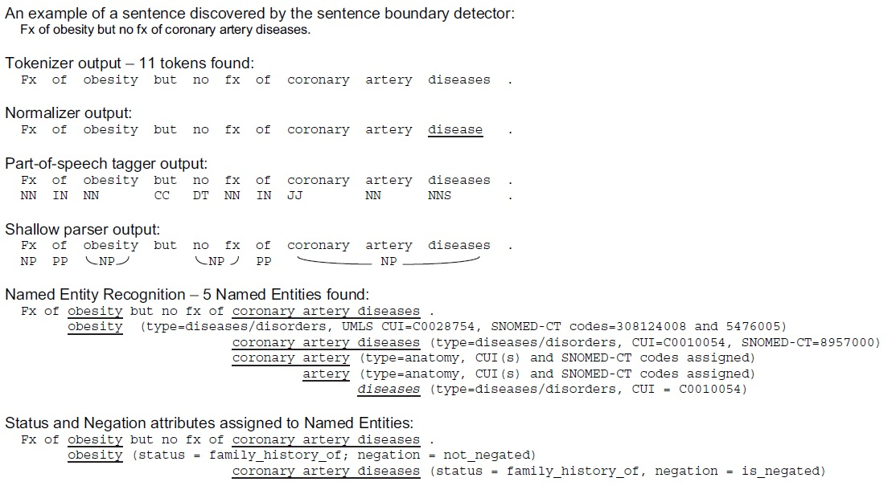
cTAKES sample output

Slide 10
Tool - YTEX
Developed by Glara V. et.al
Based on cTAKES
Used for classification of radiology reports to suggest that the case is of hepatic decompensation
Modifies cTAKES by using
  A regular expression based named entity recognition
  Latest version of NegEx algorithm to detect Negation
  A database module to store the annotations in the database

Slide 11
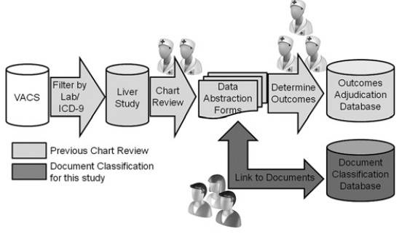
YTEX block diagram

Slide 12
Comparative study
Type of Data (ToD)
  Data used for evaluation
Application Domain (AD)
  Domain in which the tool is applicable
Preprocessing (PRE)
  If pre-processing is required or not
True Positive (TP)
  Result is positive when actually positive
True Negative (TN)
  Result is negative when actually negative
False Positive (FP)
  Result is positive when actually negative
False Negative (FN)
  Result is negative when actually positive

Slide 13
Comparative study
Precision (P) - P = TP / (TP + FP)
  Ability of the system to detect the actual positive results
Recall (R) - R = TP / (TP + FN)
  Also called sensitivity
F-score (F) - F = (2*P*R) / (P+R)
  Shows relationship between precision and recall
Ambiguity Resolution (AR)
  Capability of handling ambiguity i.e. detecting correct meaning out of a word or sentence carrying different meanings
Redundancy Handling (RH)
  Capability of handling redundancy i.e. detecting if same information is repeating again and again

Slide 14
Comparative study
Approach (A) –
  General (G) – if the system can be used for generic purpose
  Specific (S) – if the system can be used for some specific condition
Processing Type (PT) –
  Centralized (C) – capability of processing in single platform
  Distributed (D) – processing across multiple platform

Slide 15
Comparison Result
Tools\Metrics | ToD | AD | PRE | P | R | F | A | AR | RH | PT
MedEX | Medication | Clinical (Drug) | Y | 0.97 | 0.88 | 0.92 | S | Y | N | C
cTAKES | Mayo clinical EMR | Clinical (EMR) | N | 0.80 | 0.64 | 0.71 | G | N | N | C
YTEX | Radiology document | Clinical (Radiology) | N | 0.96 | 0.92 | 0.94 | S | N | N | C

Slide 16
Future Direction
Distributed processing capability
  Centralized processing requires huge resources and can cause bottleneck.
  Divide the huge data in small chunks and process across different machines
  Finally combine (aggregate) the output from individual machines
Mobile Platform
  Should be compatible for the handheld devices like Mobile, Tab etc.
Redundancy Handling
  Clinical text contains huge amount of redundant information
  Should be smart enough to detect this and prevent itself from processing same information again and again.

Slide 17
Future Direction
Ambiguity Resolution
  Semantic portion of the tools should be enhanced for ambiguity handling
  Enough training and context based analysis is needed for this

Slide 18
References
Xu, H.; Stenner, S.P.; Doan,S.;Johnson, K.B.; Waitman,L.R.;Denny, J.C MedEx: a medication information extraction system for clinical narratives; Journal of the American Medical Informatics Association (JAMIA), 2009; pp. 19-24
Savova G.K,; Masanz,J.J.; Ogren, V.P.; Zheng, J.; Sohn, S.; Kipper-Schuler, C.K.;Chute, G.C. Mayo clinical Text Analysis and Knowledge Extraction System (cTAKES): architecture, component evaluation and applications; ; Journal of the American Medical Informatics Association (JAMIA), 2010; pp. 507-513.
Garla, V.; Re, L.V. III; Dorey-Stein, Z.; Kidwai, F.; Scotch, M.; Womack,J.; Justice,A.; Brandt,C. The Yale cTAKES extensions for document classification: architecture and application Journal of the American Medical Informatics Association (JAMIA), 2011; pp. 1-7
Liddy, E.D. Natural Language Processing; Encyclopedia of Library and Information Science 2nd Edition,2001

Slide 19
References
Ronan Collobert, R.; Weston, J.; Bottou, L.; Karlen, M.; Kavukcuoglu,K.; Kuksa, P. Natural Language Processing (Almost) from Scratch; Journal of Machine Learning Research 12, 2011
Wolniewicz, R. Auto-Coding and Natural Language Processing; 3M Health Information Systems
Madnani, N.; Getting Started on Natural Language Processing with Python
Wu, Y.; Denny, C.J; Rosenbloom, S.T.; Miller, R.A.; Giuse, D.A.;Dr.Ing; Xu, H. A comparative study of current clinical natural language processing systems on handling abbreviations in discharge summaries; Department of Biomedical Informatics, Department of Medicine, School of Medicine, Vanderbilt University, Nashville, TN
Bodenreider, O.; Willis, J.; Hole, W. The Unified Medical Language System; National Library of Medicine, 2004
Klassen, P. Gate Overview and Demo; University of Washington CLMA treehouse Presentation, 2010
OpenNLP, URL - https://opennlp.apache.org/ (visited on December 2014)

Slide 20
Thank You

